Slide 1
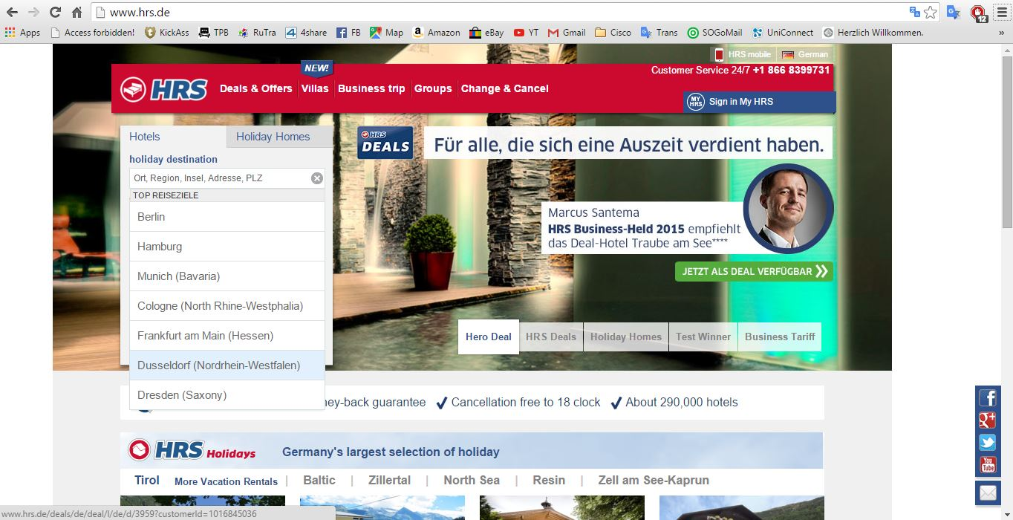
www.hrs.de

Slide 2
Category of www.hrs.de
TRANSACTIONAL / UBIQUITOUS
Hotel booking site
Search and filter based on destination, travel dates, room types
User sign-up and login
Payment
Multi-platform
Location-based recommendation

Slide 3
Web Technologies
Programming languages
Php & MySQL
Html5
XML
CSS
Javascript/AJAX
Android (Java)
iOS (Objective C)

Slide 4
Web Technologies
Protocols
HTTP
HTTPS for secure payment and login
Secure Socket Layer (SSL)
TCP/IP

Slide 5
User-Friendliness
Easy to navigate
Neat and logical interface
Supports multiple languages
One-step hotel search on the homepage
Accessible via social media (Facebook, Twitter)

Slide 6
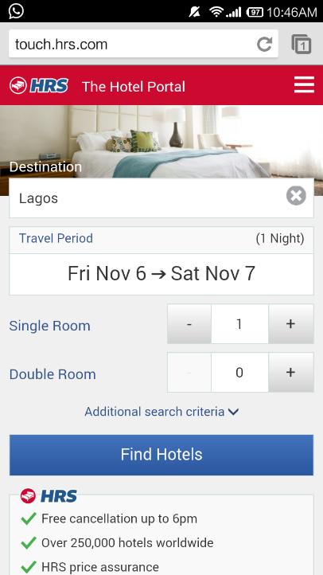
Portability
Cross-platform - mobile, tablet and desktop
Mobile apps
Convenient user feedback via social media

Slide 7
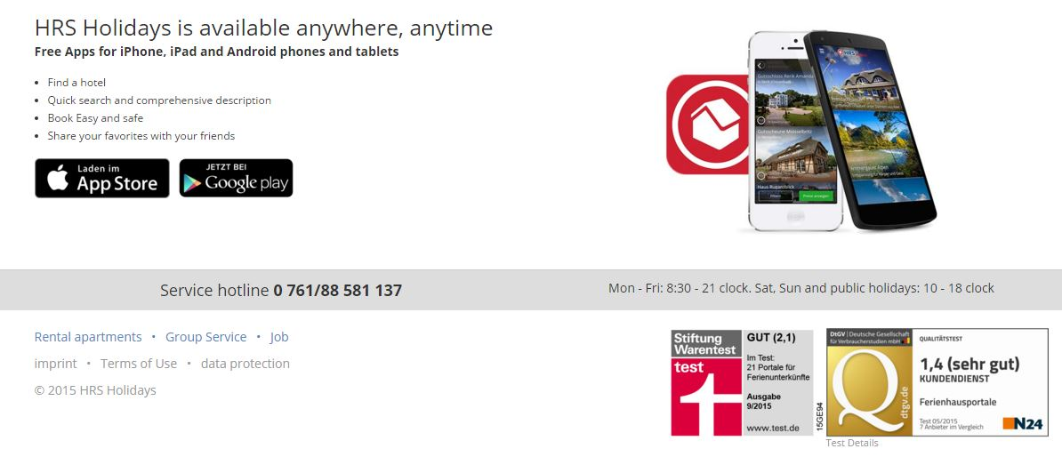
Security
SSL and HTTPS
Fair privacy policy

